Slide 1

Understanding Amazon's Low Customer Satisfaction in Singapore
Group 10:
Abhishu Tailor
Niyati Mudliar
Meera Palanivel
Nithin Thomas
Sasi Kumar
Aravind Chintalapudi
Praveen Kumar Singh Jadon

Slide 2
Contents
Introduction
Key Players in the Survey
Amazon's Performance in Singapore
Amazon's Profile and Offerings
Raw Data Analysis
Competitive Strategies
Addressing the 4 Questions
Conclusion

Slide 3
Introduction
This presentation aims to analyze the reasons behind Amazon's low customer satisfaction in Singapore, as revealed by the Customer Satisfaction Index of Singapore (CSISG). We will delve into the data and discuss potential strategies for improvement.

Slide 4
Key Players in the Survey
The CSISG covered more than 20 sub-sectors and measured over 100 companies in various industries including e-commerce, finance, insurance, info-communications, transportation, and more. The data for the e-commerce sub-sector was collected through a randomised door-to-door methodology, with a total of 1600 samples.

Slide 5
Amazon's Performance in Singapore Survey Results and Comparison
Survey Results
The latest CSISG survey results indicated that Amazon ranked last in customer satisfaction in Singapore, despite a marginal increase in scores from 70-points in 2017 to 71-points in 2018.
Comparison with US Performance
Contrary to its performance in the US, where Amazon typically tops customer satisfaction surveys, the CSISG results were unexpected. The American Customer Satisfaction Index (ACSI) saw Amazon scoring 82-points in the US, ranking a close second to retailer Costco's 83-points.

Slide 6
Amazon's Profile and Offerings Overview and Amazon Prime
Company Background
Founded in 1994, Amazon is a giant e-commerce platform offering a broad range of products and services including Amazon Prime, Amazon Web Services, Prime Video, and more.
Amazon Prime
Launched in 2005, Amazon Prime provides members with benefits such as unlimited free delivery, deals, access to movies, TV shows, and ad-free songs. By 2018, the service had 100 million paid members globally.
Amazon in Singapore
Amazon introduced Prime Now in 2017, followed by the launch of Amazon Prime. Despite much fanfare, customers faced delivery fulfilment issues, limited product offerings, and other challenges.

Slide 7
Raw Data Analysis Data Collection and Analysis
Data Collection Methodology
The data was collected via a randomised door-to-door methodology from Singaporeans and Permanent Residents, with a total of 1600 samples. A quota of N=200 was set for the top 7 most used sites.
Size of the Sample
The sample counts for various e-commerce companies were recorded, with Amazon having 200 samples. The details were collected from January to April 2018.

Slide 8
Competitive Strategies Challenges and Opportunities
Challenges Faced by Amazon
Teething issues with the launches of Prime Now and Amazon Prime, limited product offerings, and compatibility issues contributed to Amazon's low customer satisfaction.
Competitive Landscape
The e-commerce market in Singapore is highly competitive, with players vying for customer retention through various strategies such as discounts, loyalty programs, and innovative delivery methods.
Opportunities for Improvement
Thorough data analysis will aid in understanding what Amazon lacks, why consumers prefer competitors, and how Amazon could potentially improve its customer satisfaction and market share in Singapore.

Slide 9
1. Performance of Amazon based on Key Metrics Compared to Competitors
The Customer Satisfaction Index data along with the sampling details are analyzed to understand the nuances of customer experience and preferences, particularly focusing on Amazon's performance compared to its competitors.
Companies often benchmark themselves on various key performance indicators ratings. How does Amazon perform on these key metrics as compared to its competitors?
• Customer Satisfaction
• Willingness to recommend
• Average customer spend
• Frequency of visit

Slide 10
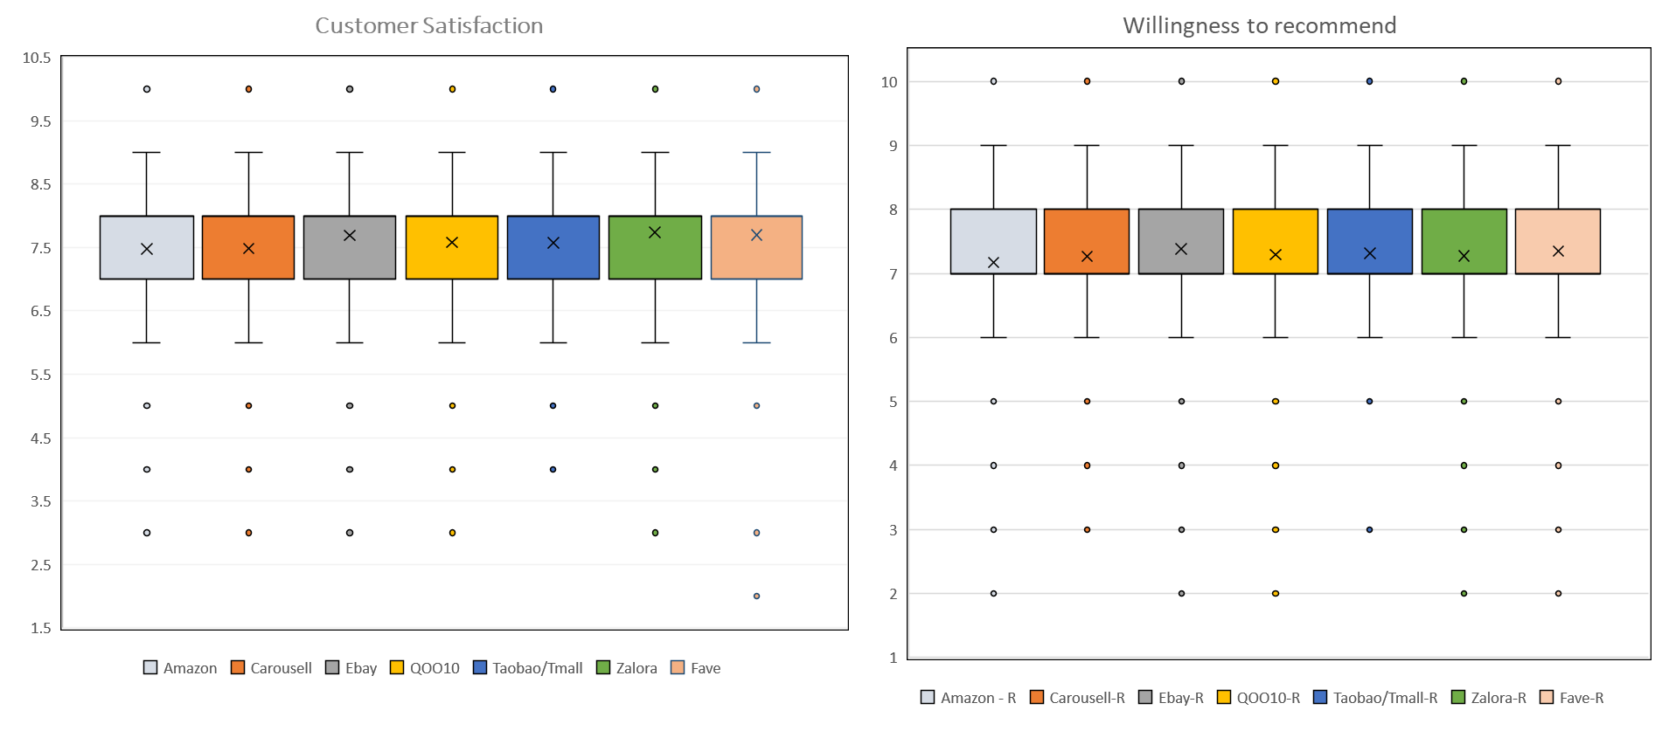
 | Minimum | Q1 | Median | Q3 | Maximum | Mean |  |  |  | Minimum | Q1 | Median | Q3 | Maximum | Mean
Amazon | 3 | 7 | 8 | 8 | 10 | 7.473204 |  |  | Amazon | 2 | 7 | 7 | 8 | 10 | 7.17
Carousell | 3 | 7 | 8 | 8 | 10 | 7.478083 |  |  | Carousell | 3 | 7 | 7 | 8 | 10 | 7.265
Ebay | 3 | 7 | 8 | 8 | 10 | 7.678107 |  |  | Ebay | 2 | 7 | 7 | 8 | 10 | 7.385
QOO10 | 3 | 7 | 8 | 8 | 10 | 7.570777 |  |  | QOO10 | 2 | 7 | 7 | 8 | 10 | 7.29
Taobao/Tmall | 4 | 7 | 8 | 8 | 10 | 7.570752 |  |  | Taobao/Tmall | 3 | 7 | 7 | 8 | 10 | 7.315
Zalora | 3 | 7 | 8 | 8 | 10 | 7.726893 |  |  | Zalora | 2 | 7 | 7 | 8 | 10 | 7.27
Fave | 2 | 7 | 8 | 8 | 10 | 7.68301 |  |  | Fave | 2 | 7 | 7 | 8 | 10 | 7.35

Slide 11
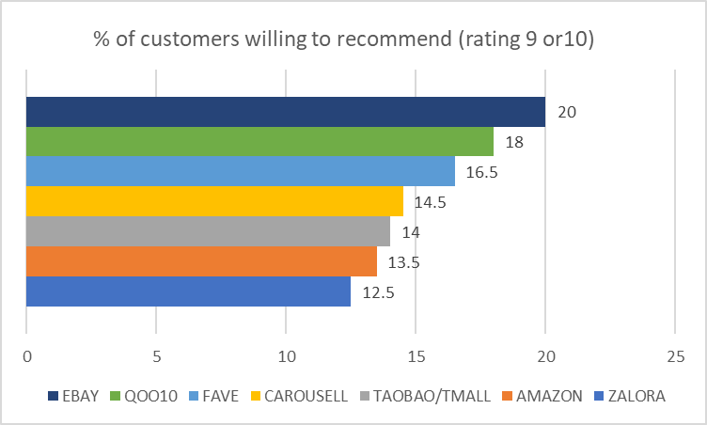

Slide 12
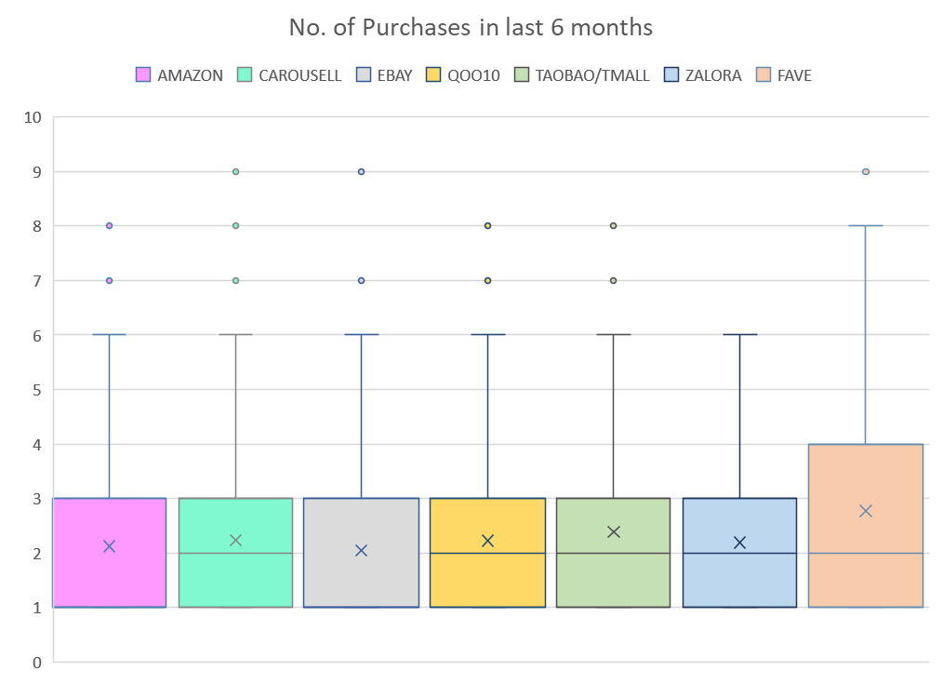
Based on Median:
Amazon was in bottom two with lower avg. purchases than others.
Based on Mean: Amazon was in bottom two with lower avg. sales than others.
 | Minimum | Q1 | Median | Q3 | Maximum | Mean
Amazon | 1 | 1 | 1 | 3 | 8 | 2.125
Carousell | 1 | 1 | 2 | 3 | 9 | 2.235
Ebay | 1 | 1 | 1 | 3 | 9 | 2.045
QOO10 | 1 | 1 | 2 | 3 | 8 | 2.23
Taobao/Tmall | 1 | 1 | 2 | 3 | 8 | 2.385
Zalora | 1 | 1 | 2 | 3 | 6 | 2.19
Fave | 1 | 1 | 2 | 4 | 9 | 2.77

Slide 13
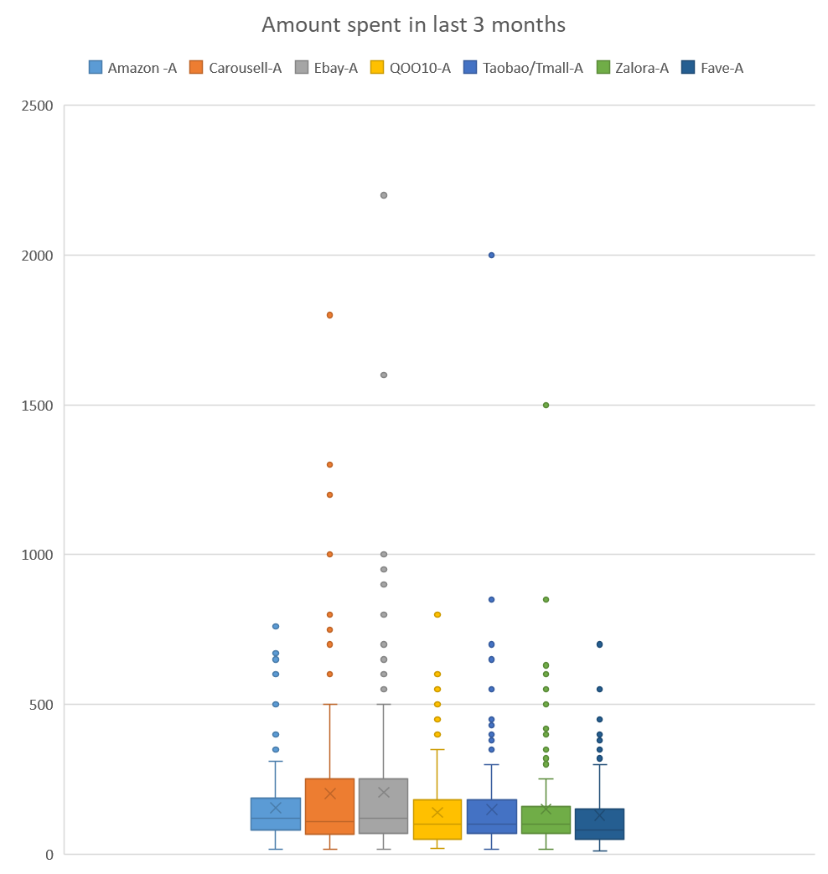
Mean Spending (average transaction amount)
Higher average spending amount : Carousell, Ebay, and Zalora
IQR and Range
Smaller IQRs and narrower ranges = more consistent or predictable spending: Amazon, Fave, and Zalora
Maximum Spending:
Brands which attract high-spending customers : Ebay, Taobao/Tmall and Carousell
Amazon failed at attracting high spending customers and had one of the lower average spending amounts out of the 7 brands.
Although, Amazon performed well in delivering a consistent/predictable spending pattern
 | Minimum | Q1 | Median | Q3 | Maximum | Mean | IQR
Amazon | 15 | 80 | 120 | 187.5 | 760 | 154.45 | 107.5
Carousell | 15 | 66.25 | 110 | 250 | 1800 | 202.9 | 183.75
Ebay | 15 | 69.25 | 120 | 250 | 2200 | 206.42 | 180.75
QOO10 | 20 | 51.25 | 100 | 180 | 800 | 138.9 | 128.75
Taobao/Tmall | 15 | 70 | 100 | 180 | 2000 | 149.15 | 110
Zalora | 15 | 70 | 100 | 160 | 1500 | 149.99 | 90
Fave | 10 | 50 | 80 | 150 | 700 | 130.215 | 100

Slide 14
Comparison of Amazon’s performance with Industry Average
Identifying the lacking areas that could potentially indicate where amazon can improve

Slide 15
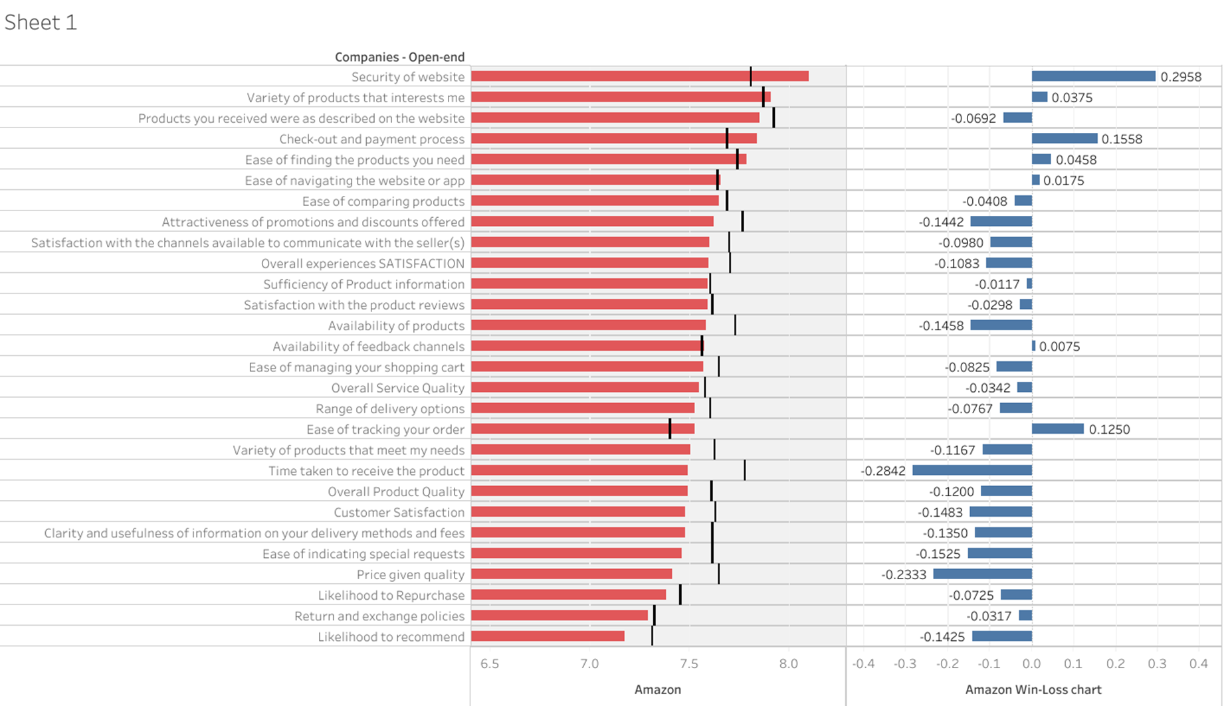
Comparing all the traits with industry average & identifying strengths and weaknesses of Amazon

Slide 16
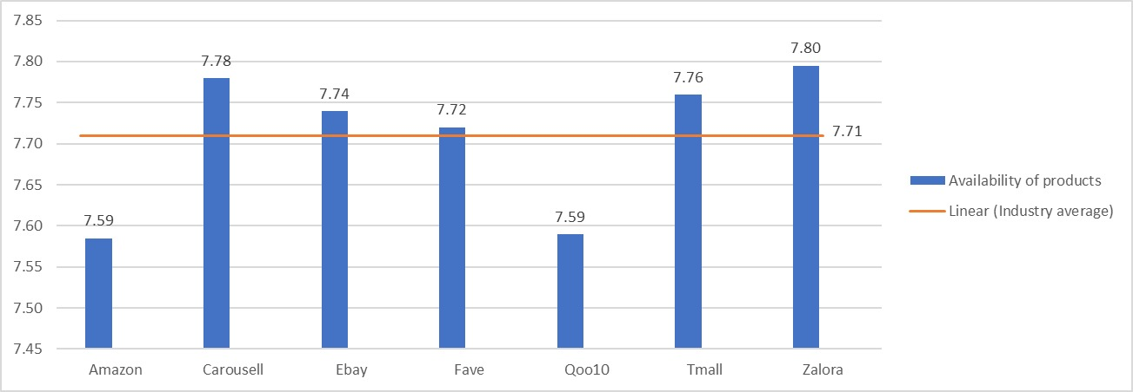
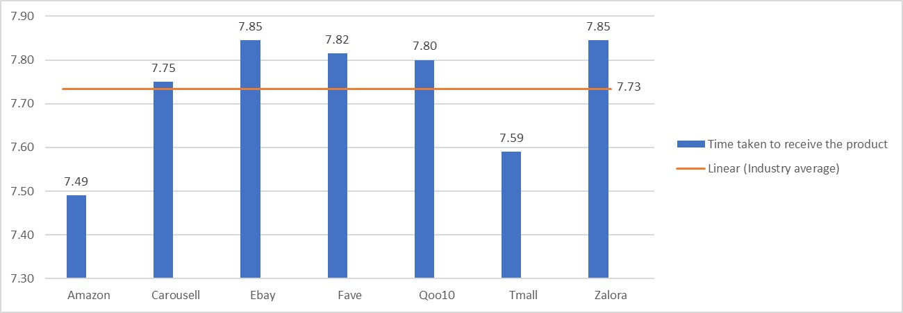
Identified major areas for customer dissatisfaction
Amazon should work on the identified weaknesses to improve its customer satisfaction index.

Slide 17
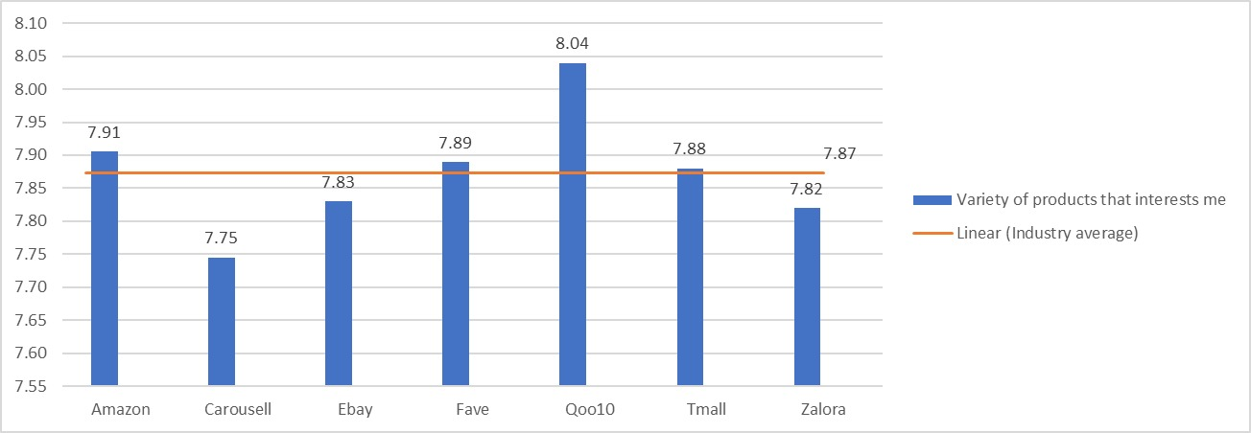
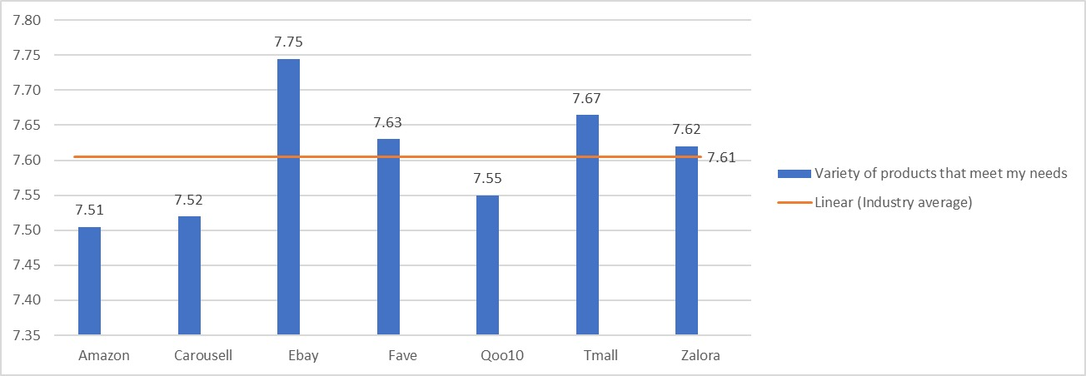
How Amazon can improve? Identify the Gap
Amazon is the second best when it comes to "variety of products that interests me" but when it comes to the second graph (variety of products that meet my needs) amazon is again rated at the lowest.
This gap basically tells us that even though the product line up at Amazon is interesting it doesn't meet the needs of the customer in Singapore. Hence Amazon should further work on their product line and include those items that meet the expectations of the customers.

Slide 18
Conclusion:
Amazon has certain strengths and mainly these are with respect to the user interface and ease of using the app, for selection of products.
While Amazon also has certain weaknesses – mainly issues with time taken for the delivery of the product.
These strengths and weaknesses are summarized in the table in the next slide.
Amazon should work on the identified weaknesses to improve its customer satisfaction index.

Slide 19
Strengths | Comparable with Industry-avg | Weaknesses
Security of website | Ease of comparing products | Attractiveness of promotions and discounts offered
Variety of products that interests me | Sufficiency of Product information | Satisfaction with the channels available to communicate with the seller(s)
Check-out and payment process | Products you received were as described on the website | Overall experiences SATISFACTION with (INSERT NAME)
Ease of finding the products you need | Ease of managing your shopping cart | Availability of products
Ease of navigating the website or app | Overall Service Quality | Variety of products that meet my needs
Availability of feedback channels | Range of delivery options | Likelihood to recommend
Ease of tracking your order | Satisfaction with the product reviews | Overall Product Quality
 | Likelihood to Repurchase | Customer Satisfaction
 | Return and exchange policies | Clarity and usefulness of information on your delivery methods and fees
 |  | Ease of indicating special requests
 |  | Price given quality
 |  | Time taken to receive the product

Slide 20
Thank you!

